Slide 1
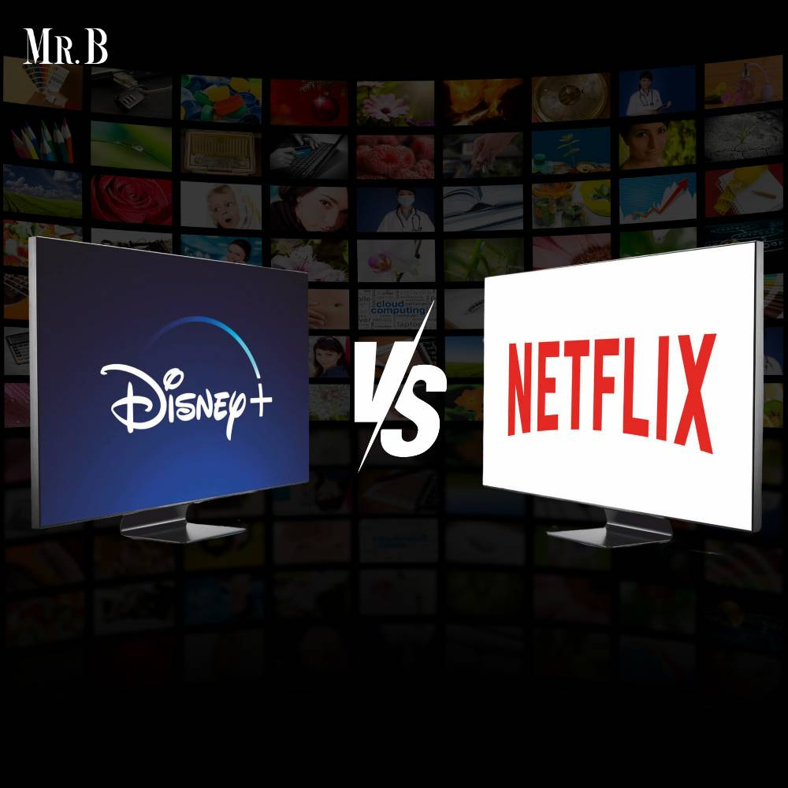



Slide 2

COMPARATIVE ANALYSIS OF NETFLIX AND DISNEY+
PREPARED BY
Hager Salah
Amera Ashraf
Toka Ahmed
Rana Ibrahim
Eva Hany
Group:
CAI1_DAT2_S1e
Company:
AST
Submitted in: oct, 2024

Slide 3

AGENDA
Introduction
Netflix Dashboard Overview
Destiny Dashboard Overview
Comparison of Dashboards
Recommendations
Conclusion

Slide 4




INTRODUCTION
HOME
SERVICE
ABOUT US
CONTACT US
This project focuses on the analysis and visualization of data from two different sources: Netflix and Disney+:
Netflix: A leading streaming platform, where understanding user behavior and content performance is crucial for driving engagement and growing the subscriber base.
Disney+: A platform with dynamic user engagement, where tracking user activity, content performance, and in-platform interactions are vital for optimizing user experience and maximizing retention.
SERVICE 04

Slide 5
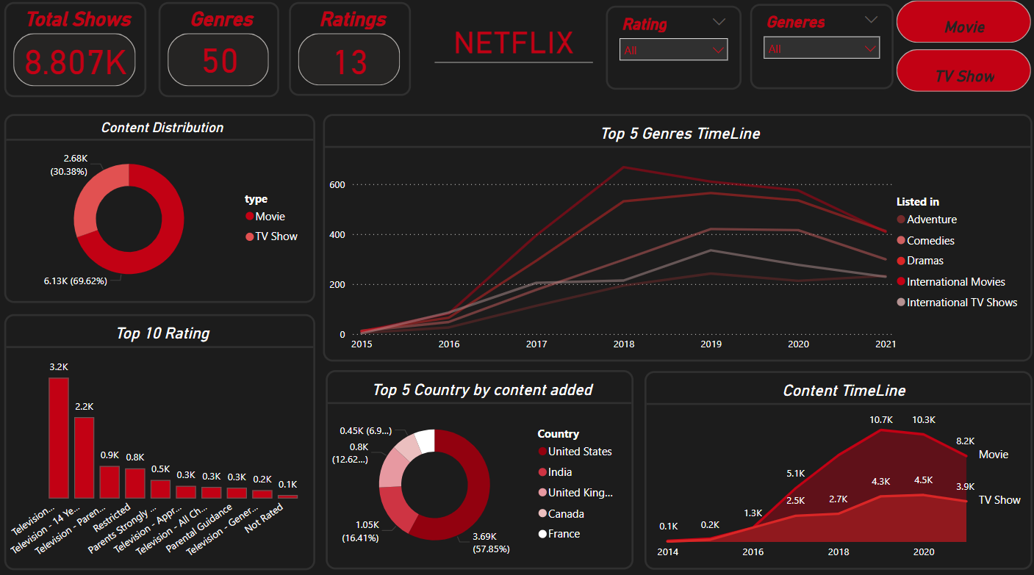
NETFLIX DASHBOARD

Slide 6
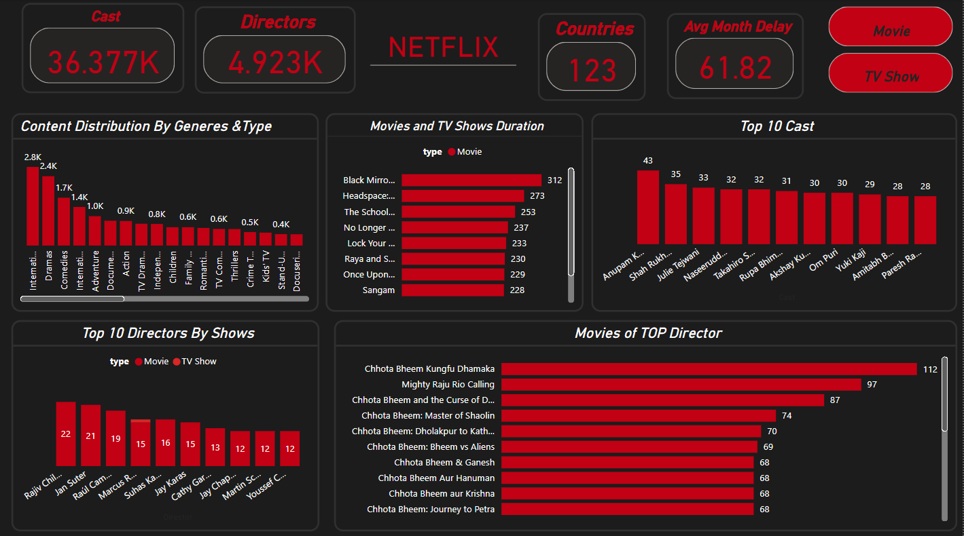
NETFLIX DASHBOARD

Slide 7
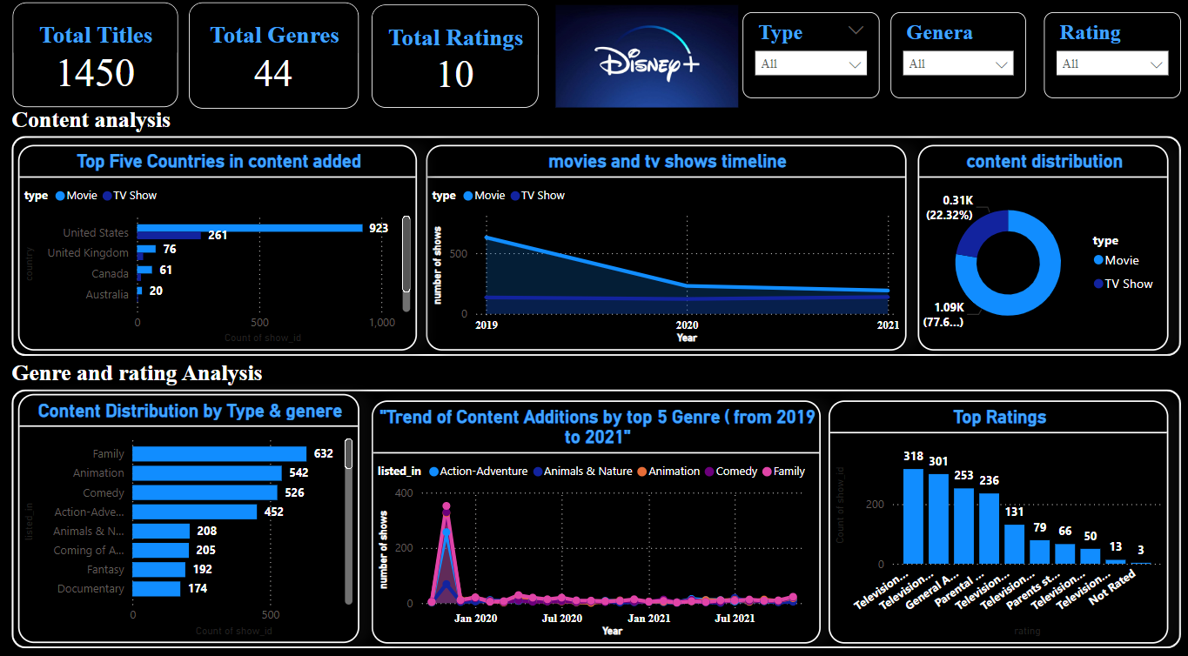
DISNEY+ DASHBOARD

Slide 8
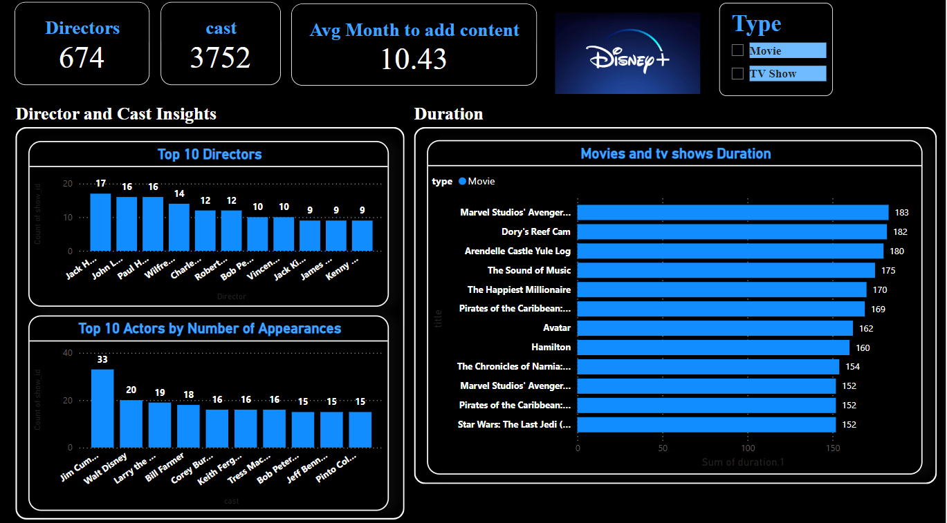
DISNEY+ DASHBOARD

Slide 9

RECOMMENDATIONS:
NETFLIX
LEVERAGE INSIGHTS FROM THE TOP-PERFORMING GENRES TO CREATE MORE TARGETED CONTENT.
Use peak viewing times to optimize content release schedules and enhance marketing efforts.
Consider user feedback and viewing patterns when developing original content to boost engagement.

Slide 10

RECOMMENDATIONS:
DISNEY +
Utilize user interaction data to refine the platform’s interface, making it more intuitive and enjoyable for users.
Focus on engagement trends to promote high-performing content and activities within the platform.
Analyze user retention metrics and improve areas where user activity drops, ensuring continuous platform use.

Slide 11

CONCLUSION
IN THIS PROJECT, WE EXPLORED TWO DISTINCT DASHBOARDS THAT UTILIZE DATA VISUALIZATION TO PROVIDE ACTIONABLE INSIGHTS FOR TWO DIFFERENT PLATFORMS—NETFLIX AND DISNEY+. BOTH DASHBOARDS HIGHLIGHT THE POWER OF USING DATA TO MAKE INFORMED DECISIONS THAT IMPROVE USER ENGAGEMENT AND OPTIMIZE PLATFORM PERFORMANCE.

Slide 12


THANK
YOU

